Slide 1
Robot Code:
Subsystems

Slide 2
How does Robot Code work?
Helpful Diagrams Ahead

Slide 3
High Level View of Robot
Robot Code is the middle man between the human inputs and the robot.
The software takes the inputs the humans make and moves the robot accordingly.
The Software is the part that the SE department is responsible for.
Input
Driver / Controller
Software
Robot Code
Hardware
Sensors / Motors

Slide 4
High Level View of Robot Subsystems
In the code there are Subsystems
Every subsystem is responsible for one functional part of the robot.
This diagram shows only one motor for each subsystem, however there are often multiple motors per subsystem.
These subsystems communicate with the hardware.
Splitting them into these groups makes the code much easier to manage.
Software
Drivetrain Subsystem
Climber Subsystem
Shooter Subsystem
new Motor(6)
new Motor(9)
new Motor(4)
Hardware
Robot Motor ID: 6
Robot Motor ID: 9
Robot Motor ID: 4

Slide 5
High Level View of Robot Commands + Subsystems
The subsystems are between the commands and the hardware.
Each command requires a subsystem to run.
The subsystem lets the commands easily talk to the hardware.
Software
Drivetrain DriveCommand
AlignAnd
ShootCommand
Shooter ShootCommand
Climber
ExtendCommand
Climber
RetractCommand
Subsystem Function Calls
Drivetrain Subsystem
Climber Subsystem
Shooter Subsystem
Hardware

Slide 6
What is a robot project?

Slide 7
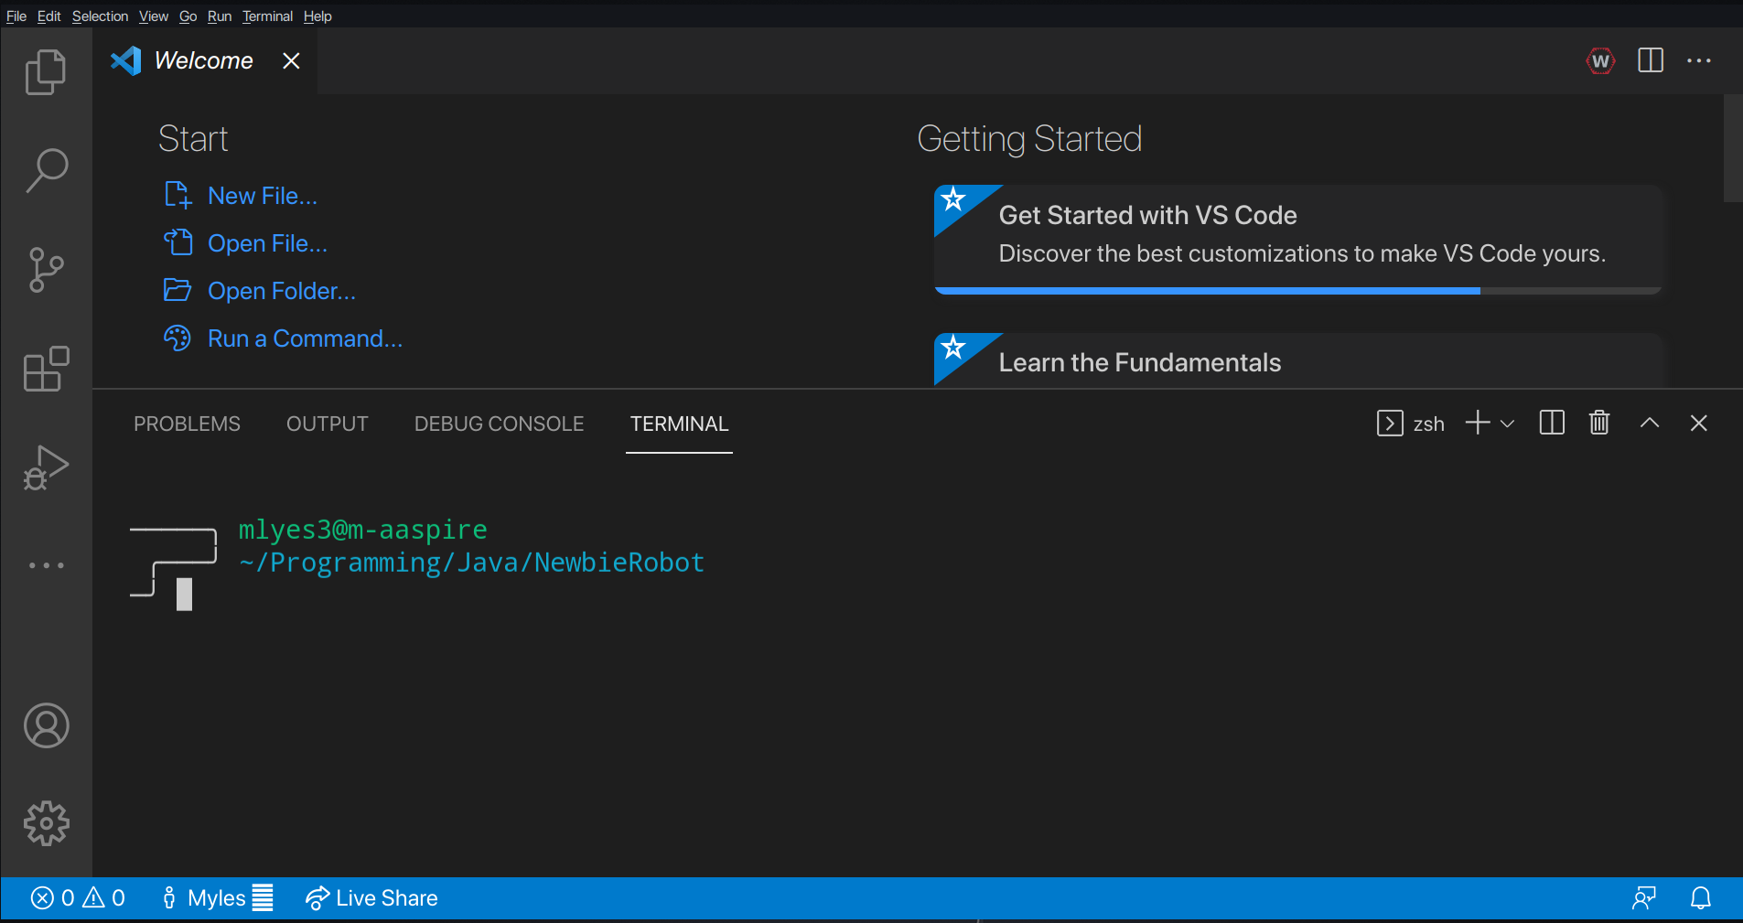
Creating a robot project
Start by creating a ..

Slide 8
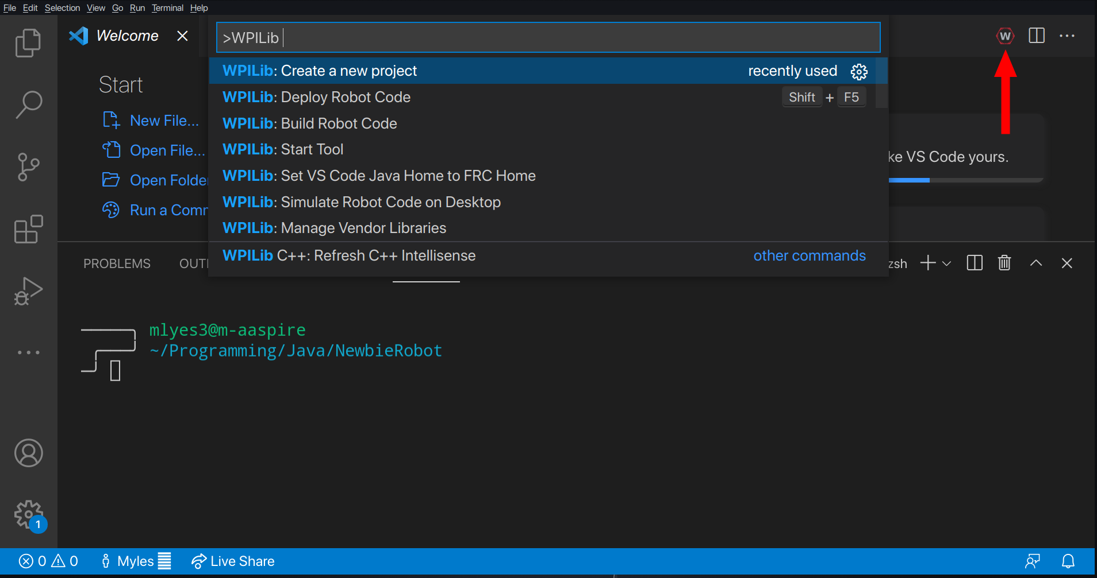
Creating a robot project
Select the WPI button to open the command menu.
Create a new project…

Slide 9
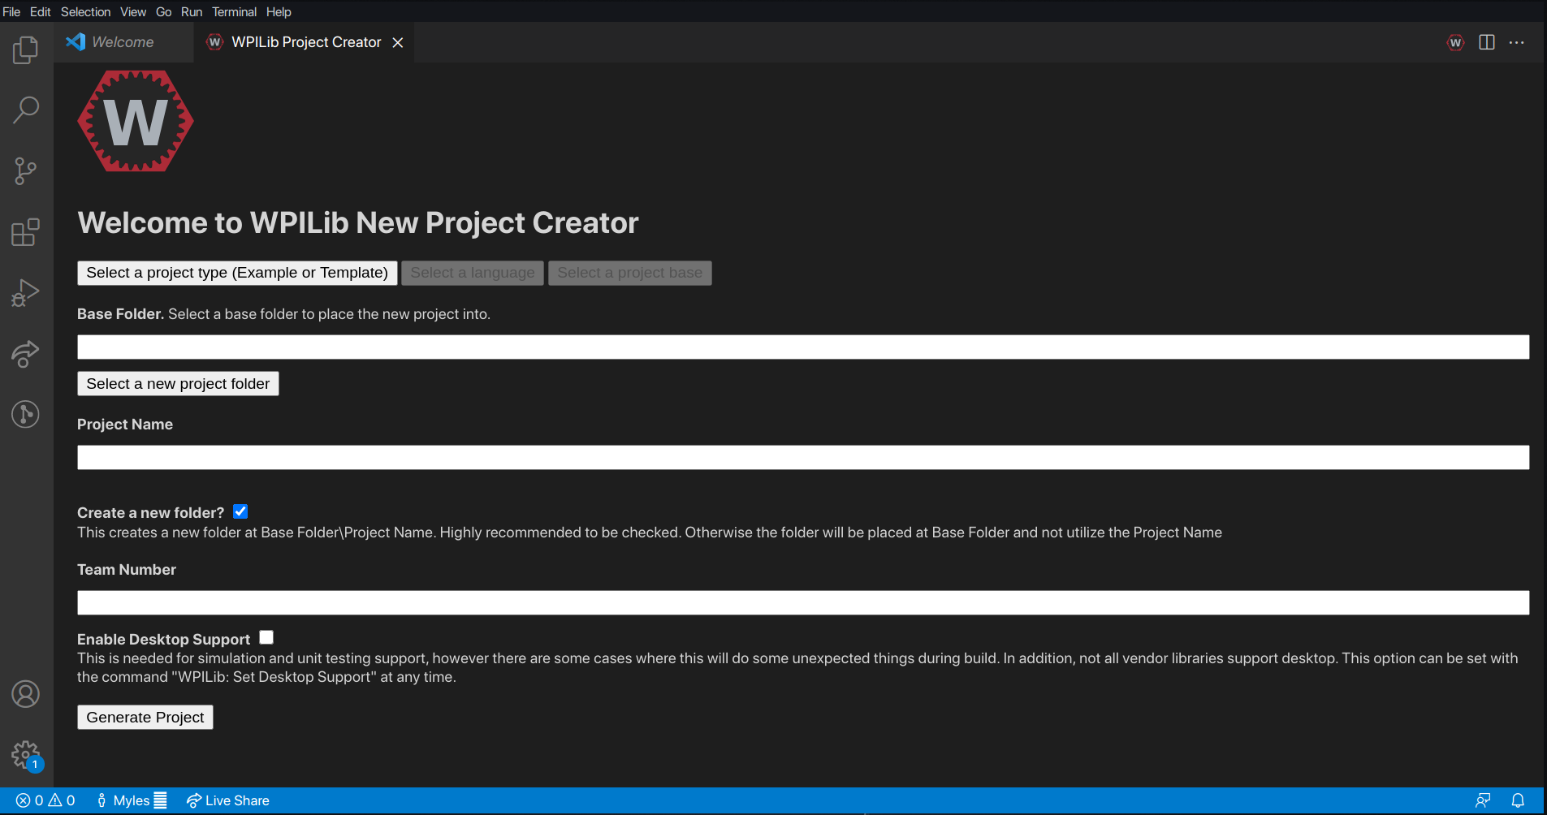
Creating a robot project
That will open this menu.
The first 3 options ask for a project type, language, and project base.
The project name and base folder determine where the project will go on your computer.
The team number is important for connecting to the robot.

Slide 10
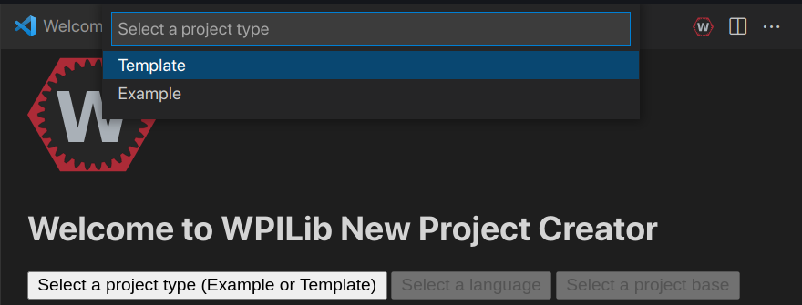
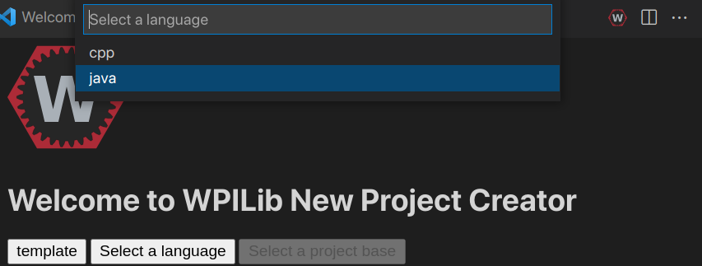
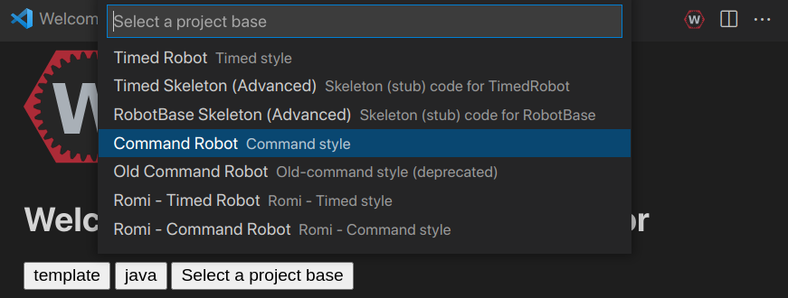
Project Type
We always work from a template project, but here is a good example robot we wrote to learn from
We code in Java
The Command Robot base allows us to create Subsystems (and later commands)

Slide 11
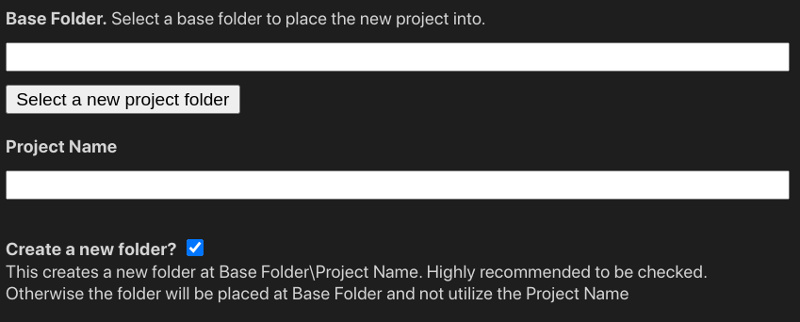
Project Location
Base folder is the folder that will contain the robot project.
If the create a new folder option is selected, it will use Project Name as a folder name.
If you are already in a folder with the name Project Name, unselect create a new folder and use the current folder as the base folder
(always enter the project name)

Slide 12
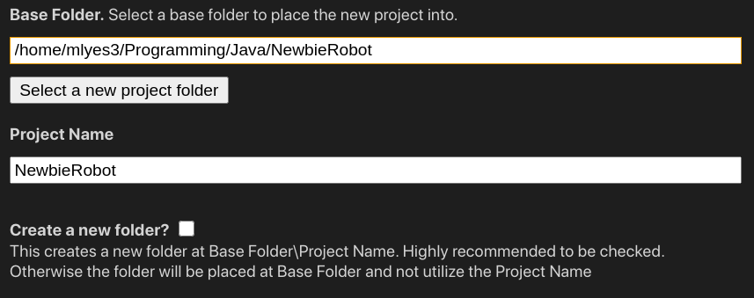
Project Location
In this case, VSCode is already open in a folder with the name of the Project, so I will uncheck create a new folder

Slide 13
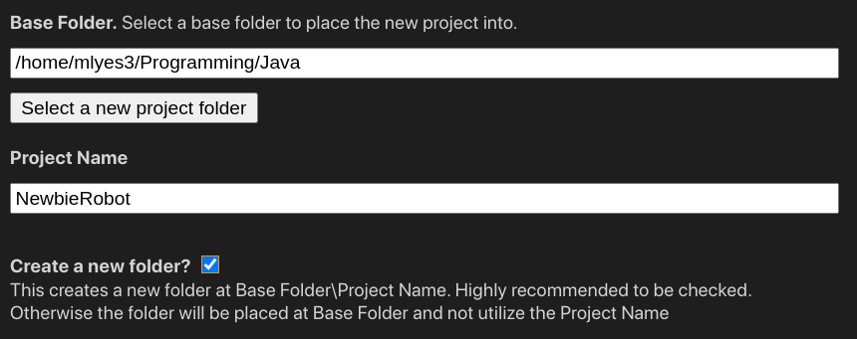
Project Location
However, if VSCode were open in the folder where I put all my robot code, I could check create a new folder

Slide 14
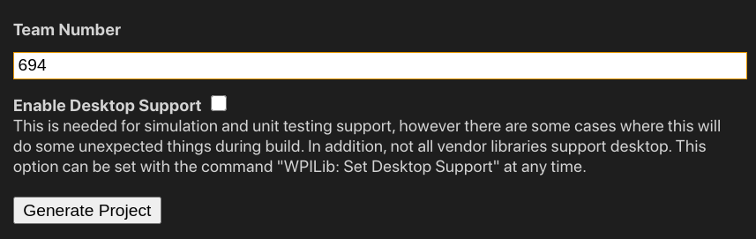
Team Number
Finally, the team number is 694 and generate project can be pressed (open the project in the current window)

Slide 15
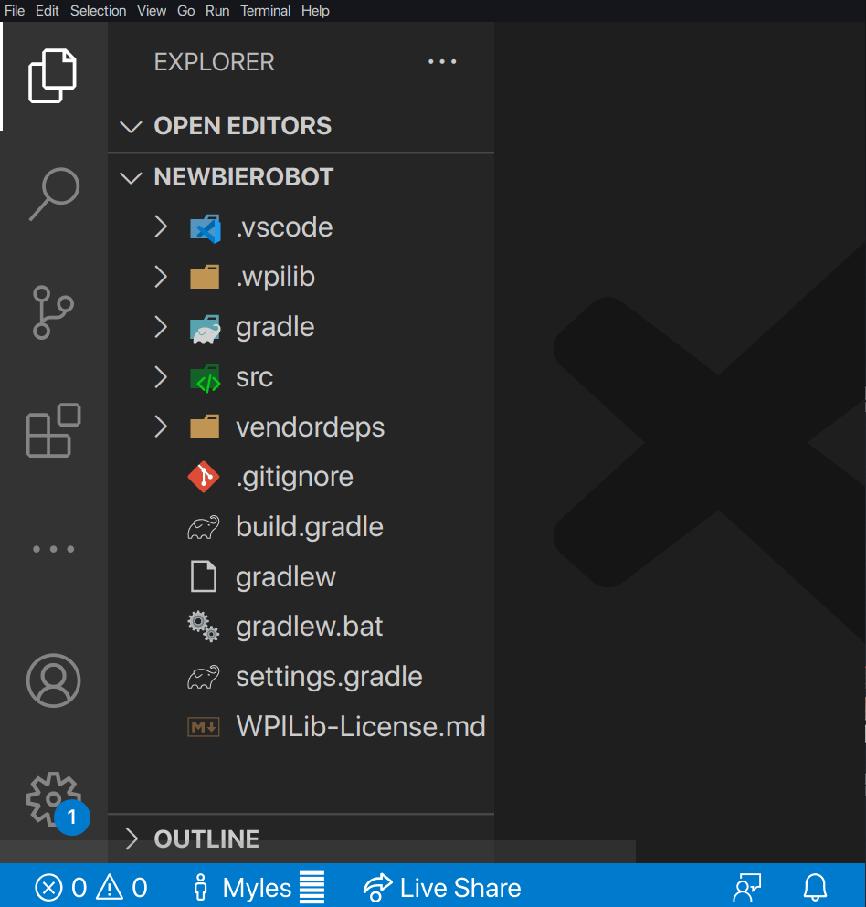
The robot code
After generating (and opening the project), this is what WPI generates

Slide 16
What’s in a robot project?

Slide 17
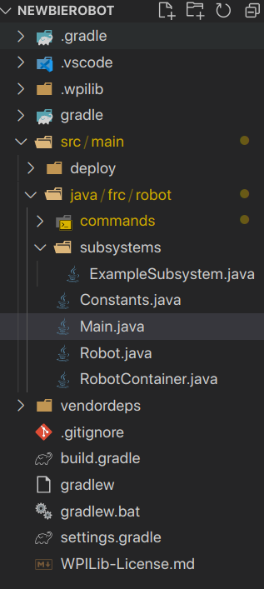
Where’s the code hiding?
All the code is in the src/ folder, usually src/main/java/frc/robot
We also notice a deploy/ folder, but this is for files we want to send over to the robot (as the robot does not have access to files on the computers we program on)

Slide 18
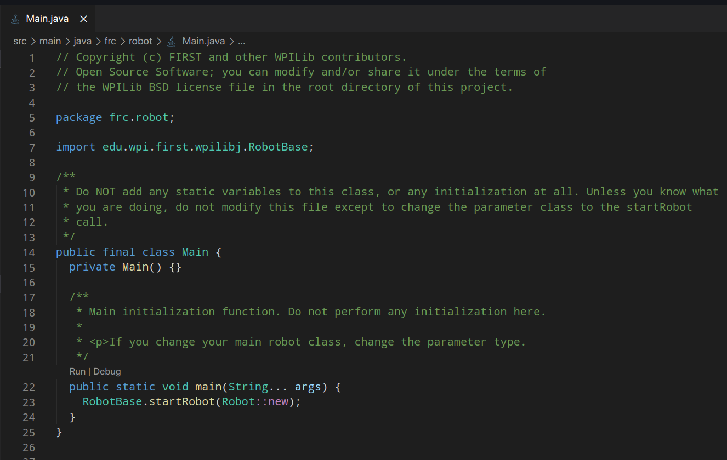
Main.java
This is the main file of the robot, as it contains public static void main.
However, we don’t modify this file, as there there’s no need to.

Slide 19
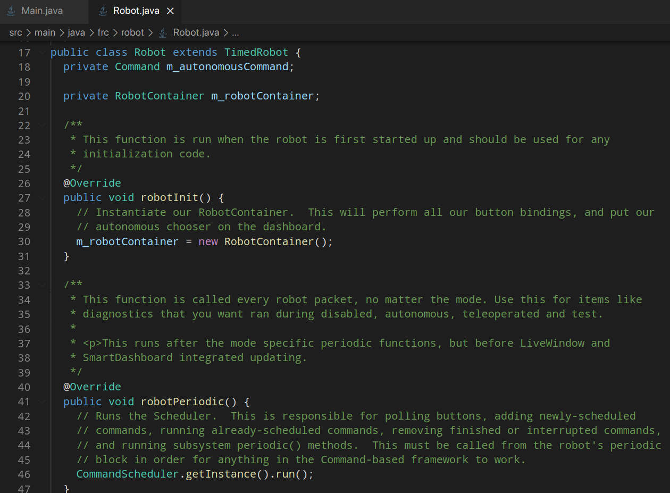
Robot.java
This file has different functions that run at specific times, like when the robot starts, or while the teleop period is active.
However, we also rarely modify this file as it’s simply a wrapper for RobotContainer

Slide 20
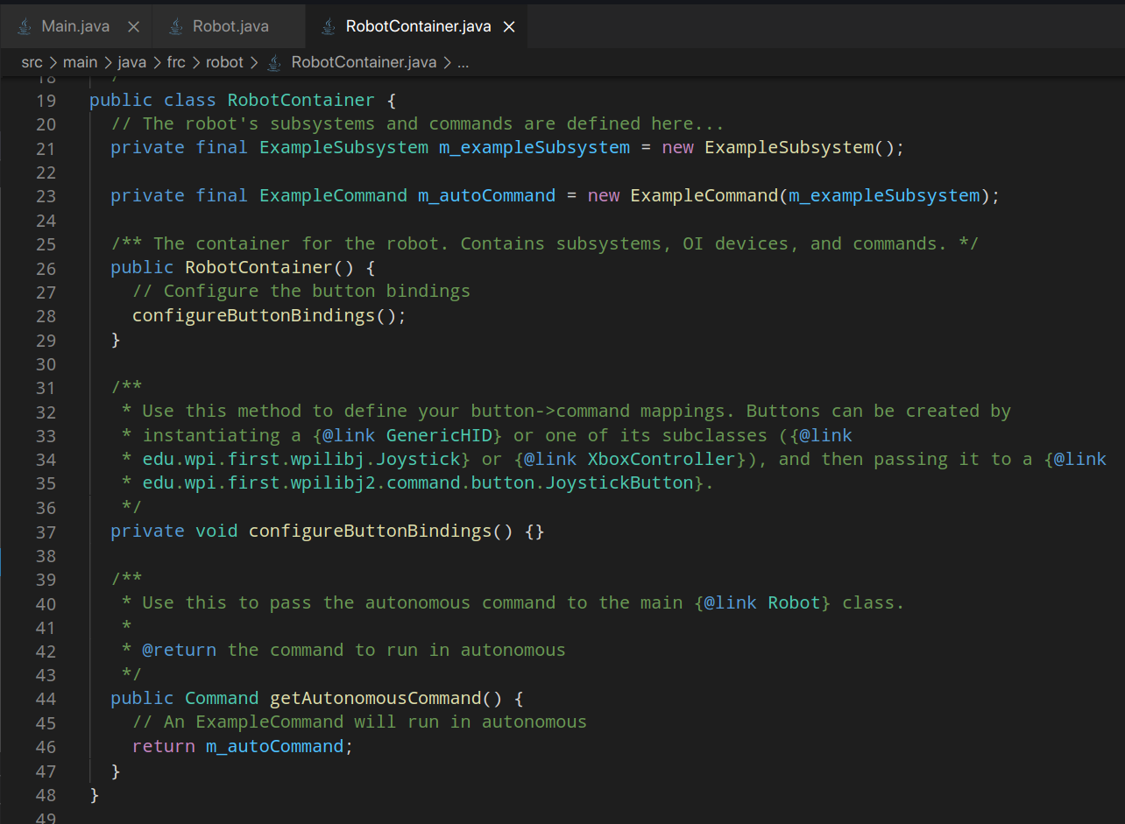
RobotContainer.java
In RobotContainer, subsystem initialization, button bindings, and commands are all setup.

Slide 21
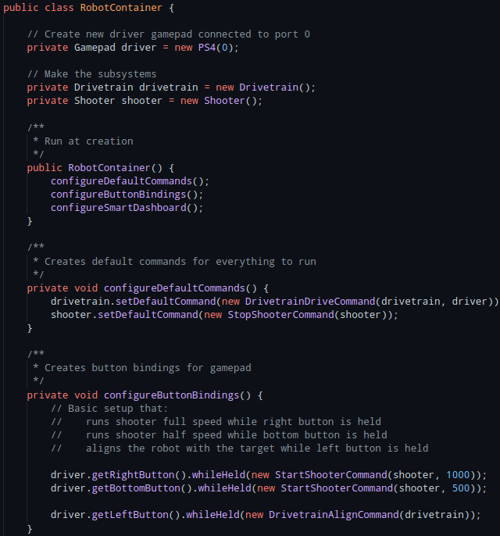
Reloaded/Destiny/RobotContainer.java
Here is RobotContainer.java, which has more substance than the template, while still being simple.
There are 2 subsystems and real gamepad code.
There are commands but there is no reason to store them as fields.

Slide 22
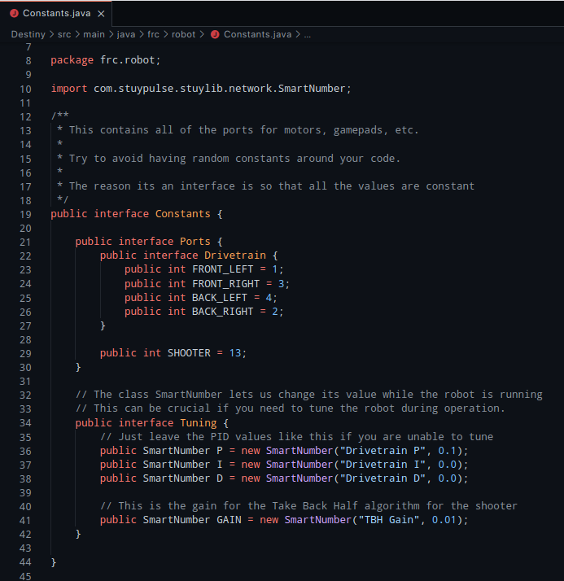
Reloaded/Destiny/Constants.java
The Constants.java from destiny is also a good example of a Constants file.
A constants file is meant to be a central file for constants for the entire robot project.

